Slide 1


Android Application Development
Unit – 3
Android UI Design Essentials
Prof. Hardik Chavda
FOCA,MU

Slide 2

Unit – 3
Animation (Frame-by-Frame, Tween)
Menu (Options, Context)
Introduction to Action Bar
Working with Alarm
Working with Telephony API
Send SMS
Working with AsyncTask
Working with VideoView
Introduction to styles and themes
Working with Camera
Working with Service
Service Life-Cycle
Types of Service
Working with AudioManager

Slide 3
Animation in android
Android supports two type os animations. Tweened animations can be used to rotate, move, stretch, and fade a View; or you can create frame-by-frame animations to display a sequence of Drawable images.
Tweened Animations:
Each tweened animation is stored in a separate XML file in the project's res/anim folder.
As with layout and drawable resources, the animation's file name is used as its resource identifier.
An animation can be defined for changes in Alpha, Scale, Translate, Rotate.
Frame-by-Frame Animations:
Frame-by-Frame animations let you create a sequence of Drawable, each of which will be displayed for a specific duration, on the background of a View.
Because frame-by-frame animations represents animated Drawable they are stored under res/drawable folder, rather than with the tweened animations, and use their file name as their Resource IDs

Slide 4
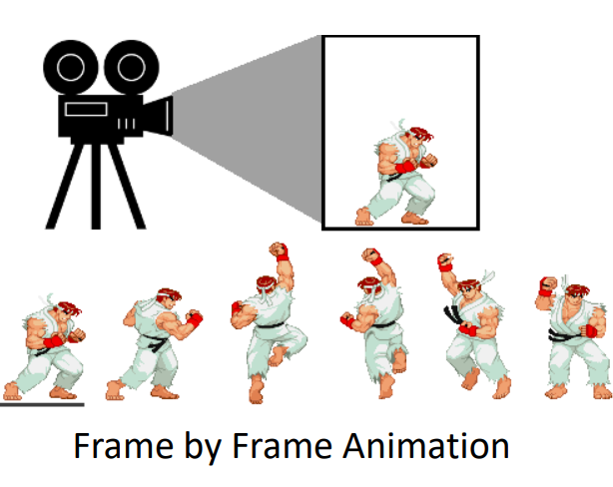


Slide 5
Tween Animation
Tween Animation takes some parameters such as
start value ,
end value,
size ,
time duration ,
rotation angle etc. and perform the required animation on that object.
It can be applied to any type of object. Android has provided us a class called Animation.
In order to perform animation in android , we are going to call a static function loadAnimation() of the class AnimationUtils.
Example
Animation animation = AnimationUtils.loadAnimation(this, R.anim.myanimation);

Slide 6
Alpha Animation (Transparency)
<?xml version="1.0" encoding="utf-8"?>
<set xmlns:android="http://schemas.android.com/apk/res/android"
android:duration="3000"
android:fillAfter="true">
<alpha
android:fromAlpha="100"
android:toAlpha="0" />
</set>
b_alpha.setOnClickListener(new View.OnClickListener() {
@Override
public void onClick(View v) {
Animation animation = AnimationUtils.loadAnimation(MainActivity.this, R.anim.alpha);
txt.startAnimation(animation); }
});

Slide 7
Rotate (for rotation)
<?xml version="1.0" encoding="utf-8"?>
<set xmlns:android="http://schemas.android.com/apk/res/android"
android:duration="3000"
android:fillAfter="true">
<rotate
android:fromDegrees="0"
android:pivotX="50%"
android:pivotY="50%"
android:toDegrees="360" />
</set>
b_rotate.setOnClickListener(new View.OnClickListener() {
@Override
public void onClick(View v) {
Animation animation = AnimationUtils.loadAnimation(MainActivity.this, R.anim.rotate);
txt.startAnimation(animation);
}
});

Slide 8
Scale (for Size)
<?xml version="1.0" encoding="utf-8"?>
<set xmlns:android="http://schemas.android.com/apk/res/android"
android:duration="3000"
android:fillAfter="true"> <scale
android:fromXScale="1"
android:fromYScale="1"
android:pivotX="50%"
android:pivotY="50%"
android:toXScale="0"
android:toYScale="0" /> </set>
b_scale.setOnClickListener(new View.OnClickListener() {
@Override
public void onClick(View v) {
Animation animation = AnimationUtils.loadAnimation(MainActivity.this, R.anim.scale);
txt.startAnimation(animation);
}
});

Slide 9
Translate (for Moving)
<?xml version="1.0" encoding="utf-8"?>
<set xmlns:android="http://schemas.android.com/apk/res/android"
android:duration="3000"
android:fillAfter="true">
<translate
android:fromXDelta="0"
android:fromYDelta="0"
android:toXDelta="-100"
android:toYDelta="-200" /> </set>
b_translate.setOnClickListener(new View.OnClickListener() {
@Override
public void onClick(View v) {
Animation animation = AnimationUtils.loadAnimation(MainActivity.this, R.anim.trans);
txt.startAnimation(animation);
}
});

Slide 10
Frame By Frame Animation
An object used to create frame-by-frame animations, defined by a series of Drawable objects, which can be used as a View object’s background.
The simplest way to create a frame-by-frame animation is to define the animation in an XML file, placed in the res/drawable/ folder,
Set it as the background to a View object. Then, call start() to run the animation.
An Animation Drawable defined in XML consists of a single <animation-list> element and a series of nested <item> tags.
Each item defines a frame of the animation.
XML attributes
android:drawableReference to a drawable resource to use for the frame.
android:duration Amount of time (in milliseconds) to display this frame.
android:oneshot If true, the animation will only run a single time and then stop.

Slide 11
Example
<?xml version="1.0" encoding="utf-8"?>
<animation-list xmlns:android="http://schemas.android.com/apk/res/android"
android:oneshot="false">
<item android:drawable="@drawable/cb1" android:duration="60"/>
.
.
<item android:drawable="@drawable/cb60" android:duration="60"/>
</animation-list>
b_frame.setOnClickListener(new View.OnClickListener() {
@Override
public void onClick(View v) {
img.setImageResource(0);
img.setBackgroundResource(R.drawable.animation);
AnimationDrawable anim = (AnimationDrawable) img.getBackground();
anim.start();
}
});

Slide 12
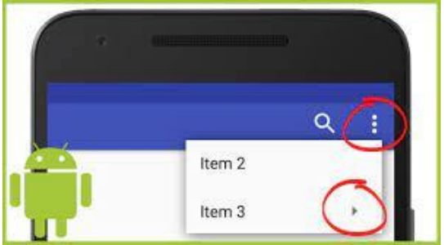
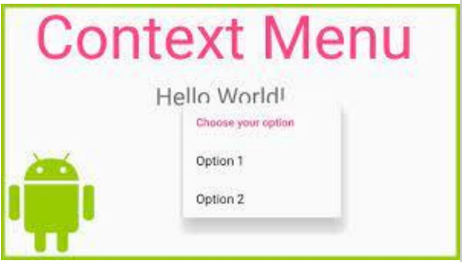
Menu (Options, Context)
Menus are a common user interface component in many types of applications. To provide a familiar and consistent user experience, provides different ways of options.
Two different type of menus can be created in Android.
Option Menu
Context Menu

Slide 13
Context Menu
Context Menu-displays information about a specific View in an Activity.
In Android, the context menu is activated by pressing and holding for a period of time.
Context Menu needs to override the onCreateContextMenu() and onContextItemSelected() methods.
When the ContextMenu is created, onCreateContextMenu() is called, and onContextItemSelected() is called when the option is selected.

Slide 14
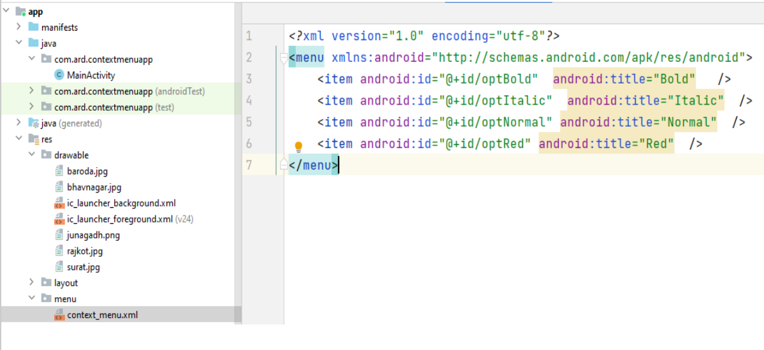
First create xml resource file of menu items as per below

Slide 15
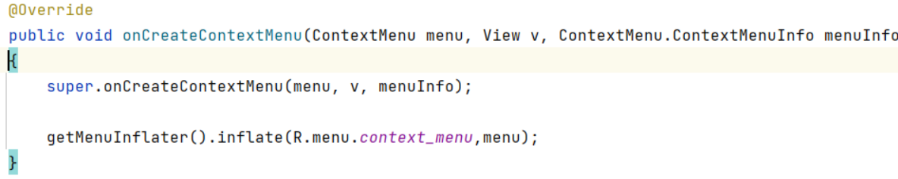
Create onCreateContextMenu( ) method
A MenuInflater is an object that is able to create Menu from xml resources.
A MenuInflater can "inflate" menu resources, converting the XML representation into a tree of Menu and MenuItem objects

Slide 16
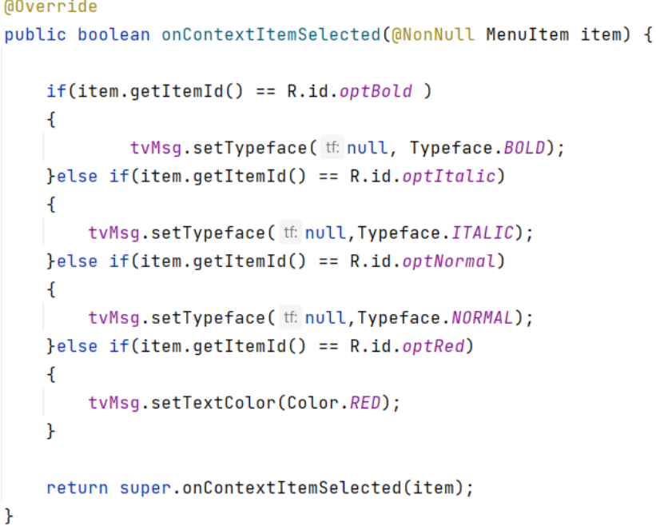
onContextItemSelected ( ) method : It returns the selected item.

Slide 17
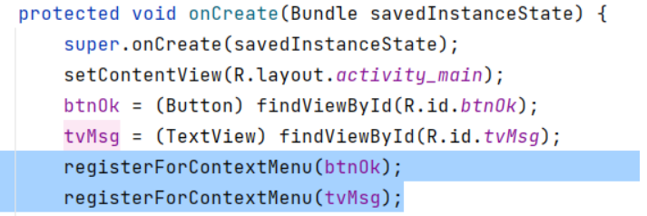
In Activity class, there is method called registerForContextMenu(View view).
This method is used to registers a context menu to be shown for the given view (multiple views can show the context menu).

Slide 18
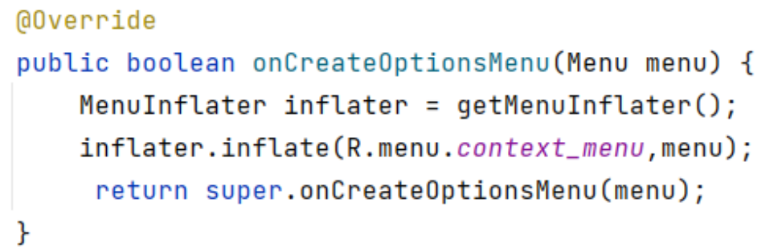
Options Menu
Options Menu-Display the information of the current Activity. In Android, activate the options menu by pressing the MENU button.
Options Menu needs to rewrite two methods-onCreateOptionsMenu() and onOptionsItemSelected().
The onCreateOptionsMenu() method is called when the MENU button is pressed. When a menu item is selected, the onOptionsItemSelected() method will be called.
onCreateOptionsMenu ( ) method
A MenuInflater is an object that is able to create Menu from xml resources.
A MenuInflater can "inflate" menu resources, converting the XML representation into a tree of Menu and MenuItem objects.

Slide 19
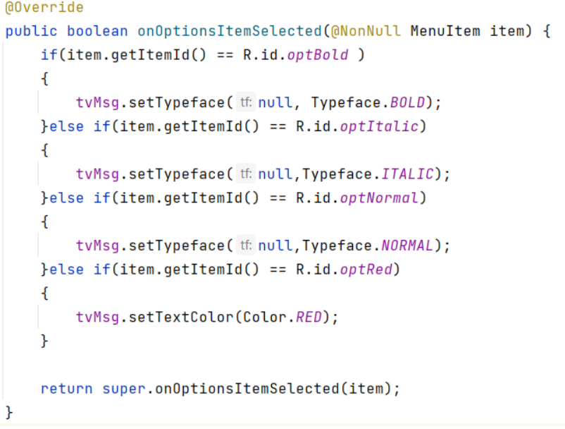

Slide 20
Action Bar
Android ActionBar is a menu bar that runs across the top of the activity screen in android.
Android ActionBar can contain menu items which become visible when the user clicks the “menu” button.
In general an ActionBar consists of the following four components:
App Icon
View Control
Action Buttons
Action Overflow
App Icon: App branding logo or icon will be displayed here
View Control: A dedicated space to display Application title. Also provides option to switch between views by adding spinner or tabbed navigation
Action Buttons: Some important actions of the app can be added here ▪Action
Overflow: All unimportant action will be shown as a menu

Slide 21
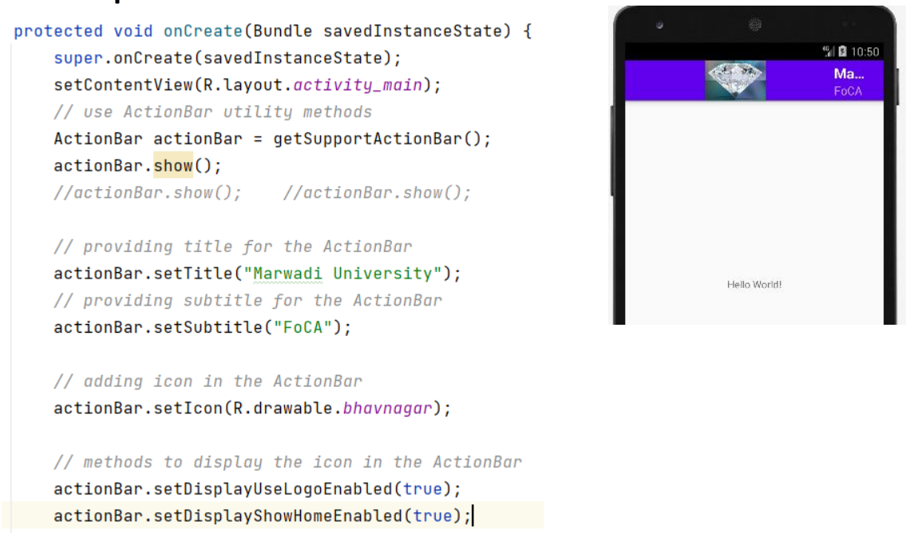

Slide 22
Introduction of AlarmManager
Android AlarmManager allows you to access system alarm.
By the help of Android AlarmManager in android, you can schedule your application to run at a specific time in the future. It works whether your phone is running or not.
The Android AlarmManager holds a CPU wake lock that provides guarantee not to sleep the phone until broadcast is handled.
AlarmManager is a bridge between application and Android system alarm service. It can send a broadcast to your app (which can be completely terminated by user) at a scheduled time and your app can then perform any task accordingly.
getSystemService() method is used when we want to access one of few Android system-level services. To name only few of managers that we can get: LocationManager – access GPS device information. NotificationManager – manage (create, cancel) notifications.
PendingIntent lets us pass a future Intent to another application and allow that application to execute that Intent as if it had the same permissions as our application.
A broadcast receiver (receiver) is an Android component which allows you to register for system or application events. All registered receivers for an event are notified by the Android runtime once this event happens.

Slide 23
Telephony API
Android Telephony is a package provided by Android to operate and get information about the network interfaces and device details. It has several interfaces and classes that are used to provide various functionalities.
Android Telephony Manager is one such class that is present in the android.telephony package. It provides you with several methods to get the network or telephony information and know its current state.
To access the Telephony Manager in your programming, you can simply import the android.telphony.TelephonyManager class.
After that, you need to use the getSystemService() to create the TelephonyManager object, and then you can use it to get system information.

Slide 24
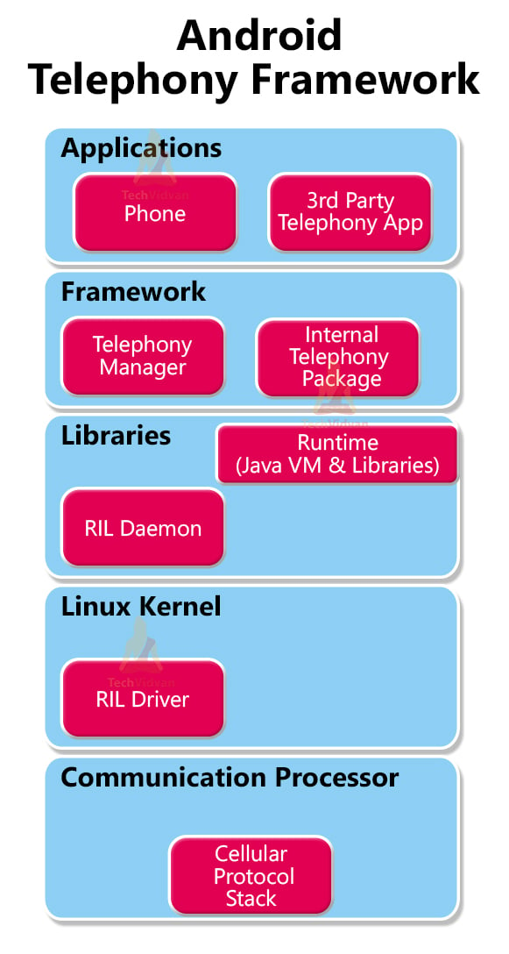
Architecture of Telephony API
Communication Processor
The communication processor is used to communicate and collect data from various peripherals.
Radio Interface Layer (RIL)
The Radio Interface Layer is an interface through which the hardware components interact with the frameworks. It’s a bridge with protocols for the Telephony services and is therefore known as protocol stack for Telephone. The RIL consist of two components that are as follows:
a. RIL Daemon – RIL Daemon starts up immediately when your device starts. The RIL Daemon reads system properties and makes the libraries ready that are required by Vendor RIL.
b. Vendor RIL – Vendor RIL is a library that is specific to each network modem.

Slide 25
Framework Services
Framework services consist of various packages and assists the Telephony Manager in directing all the application API requests to RIL. The framework services start immediately when the device boots up.
Application
Applications are the last layer of the Telephony architecture. The applications are used directly by the user to interact with the Telephony Services. Some of the standard applications are IMEI checker, Dialer, SIM Toolkit, Browser, etc.

Slide 26
Telephony Applications:
Dialer
Contacts
Messaging — SMS/MMS(BasicSmsReceiver)
Settings app — a) Airplane mode b) APN settings C)Network selection (auto/manual) d) Call settings, such as, call waiting, call forwarding/diverting e) CLIR f)FDN
SIM Application Toolkit (SAT)
Browser
CellBroadcastReceiver
CarrierConfig
PhoneCommon
Example
TelephonyManager telephonyManager = (TelephonyManager) getSystemService(Context.TELEPHONY_SERVICE)

Slide 27
AsyncTask
Android AsyncTask going to do background operation on background thread and update on main thread. ▪In android we cant directly touch background thread to main thread in android development.
asynctask help us to make communication between background thread to main thread.
The following are the useful methods of AsyncTask<Params,Progress,Result>.
onPreExecute()
doInBackground(Params)
onProgressUpdate(Progress…)
onPostExecute(Result)

Slide 28
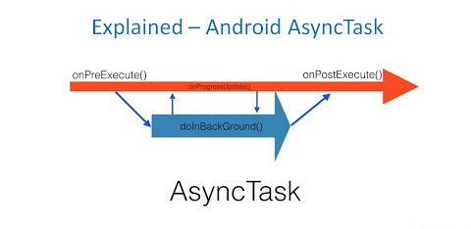
onPreExecute() − Before doing background operation we should show something on screen like progress bar or any animation to user.
doInBackground(Params) − In this method we have to do background operation on background thread.
Operations in this method should not touch on any main thread activities or fragments.
onProgressUpdate(Progress…) − ▪While doing background operation, if you want to update some information on UI, we can use this method.
onPostExecute(Result) − In this method we can update ui of background operation result.

Slide 29
VideoView
VideoView is a UI widget that is used to display video content to the users within android applications.
We can add video in this video view from different resources such as a video stored on the user device, or a video from a server.
By the help of MediaController and VideoView classes, we can play the video files in android.
MediaController class
The android.widget.MediaController is a view that contains media controls like play/pause, previous, next, fast-forward, rewind etc.
VideoView class
The android.widget.VideoView class provides methods to play and control the video player

Slide 30
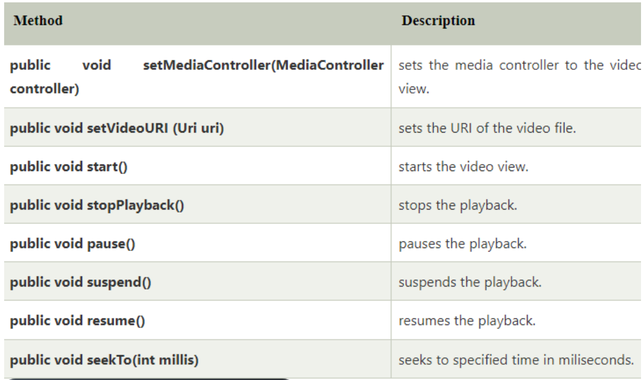
VideoView Methods

Slide 31
Introduction to styles & Themes
Styles
A style is a collection of attributes that specify the appearance for a single View .
A style can specify attributes such as font color, font size, background color, and much more.
A style resource defines the format and look for a UI.
A style can be applied to an individual View(from within a layout file) or to an entire Activity or application (from within the manifest file).

Slide 32
Themes
A theme is a collection of attributes that's applied to an entire app, activity, or view hierarchy—not just an individual view.
When you apply a theme, every view in the app or activity applies each of the theme's attributes that it supports.
A theme is nothing but an Android style applied to an entire Activity or application, rather than an individual view.
When a style is applied as a theme, every view in the Activity or application will apply each style property that is supports.

Slide 33
Working with Camera
If you want to add camera functionality to an Android app, you have three main options:
CameraX
For most developers,it is recommended CameraX. CameraX is a Jetpack library that supports the vast majority of Android devices (Android 5.0 and higher) and provides a consistent, high-level API designed around common use cases. CameraX resolves device compatibility issues for you so that you don't have to add device-specific code to your app.
Camera2
CameraX is built on top of the Camera2 package. If you need low-level camera control to support complex use cases, Camera2 is a good option, but the API is more complex than CameraX. It requires you to manage device-specific configurations. Like CameraX, Camera2 works on Android 5.0 (API level 21) and higher.
Camera (deprecated)
The original Android Camera class is deprecated. New apps should use CameraX (recommended) or Camera2, and existing apps should migrate to take advantage of new features and to avoid losing compatibility with future devices.

Slide 34
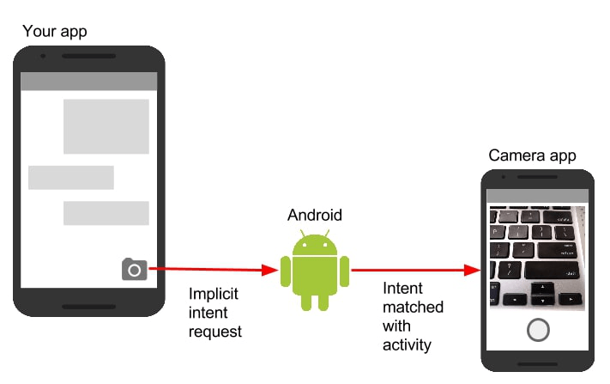
Camera intents
To perform basic camera actions like capturing a photo or video using the device's default camera application, you do not need to integrate with a Camera library. Instead, use an Intent.
Android delegates actions to other applications by invoking an Intent. This process involves three pieces: the Intent itself, a call to start the external Activity, and some code to handle the image data when focus returns to your activity.

Slide 35
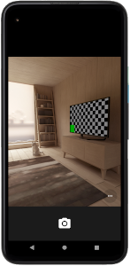
To take picture
static final int REQUEST_IMAGE_CAPTURE = 1;
private void dispatchTakePictureIntent() {
Intent takePictureIntent = new Intent(MediaStore.ACTION_IMAGE_CAPTURE);
try {
startActivityForResult(takePictureIntent, REQUEST_IMAGE_CAPTURE);
} catch (ActivityNotFoundException e) {
// display error state to the user
}
}

Slide 36
To take video
static final int REQUEST_VIDEO_CAPTURE = 1;
private void dispatchTakeVideoIntent() {
Intent takeVideoIntent = new Intent(MediaStore.ACTION_VIDEO_CAPTURE);
if (takeVideoIntent.resolveActivity(getPackageManager()) != null) {
startActivityForResult(takeVideoIntent, REQUEST_VIDEO_CAPTURE);
}
else {
//display error state to the user
}
}

Slide 37
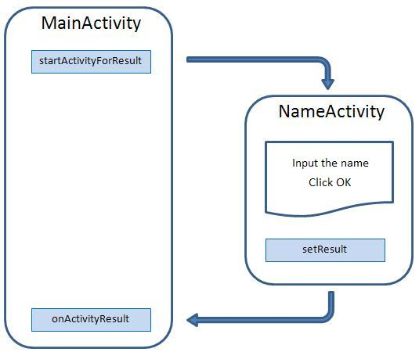
startActivityForResult()
The startActivityForResult() method is protected by a condition that calls resolveActivity(), which returns the first activity component that can handle the Intent. Perform this check to ensure that you are invoking an Intent that won't crash your app.

Slide 38
Working with Service
Certainly! In Android, services are a crucial component that allows applications to perform long-running tasks in the background.
3 Types of Services:
Foreground Services:
These services notify users about their ongoing operations. Users can interact with them through notifications. For example, when downloading a file, users can track the progress and even pause or resume the process.
Foreground services are suitable for tasks that require user awareness and interaction.
Background Services:
Background services operate without user intervention. They don’t notify users about ongoing tasks, and users cannot directly access them.
Examples of background services include scheduled data syncing or data storage processes.
Bound Services:
Bound services allow application components (such as activities) to bind themselves to the service.
Multiple components can bind to a service simultaneously.
Inter-process communication (IPC) can occur between the components and the service.
To bind an application component to a service, use the bindService() method.

Slide 39
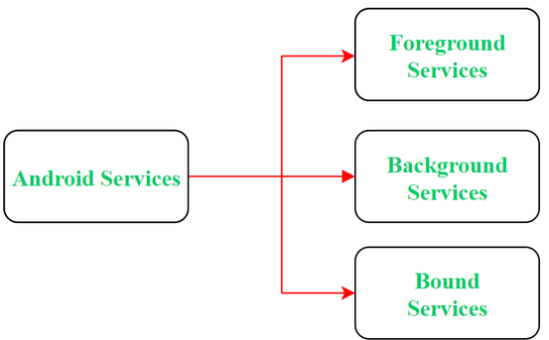
3 Types of Services:

Slide 40
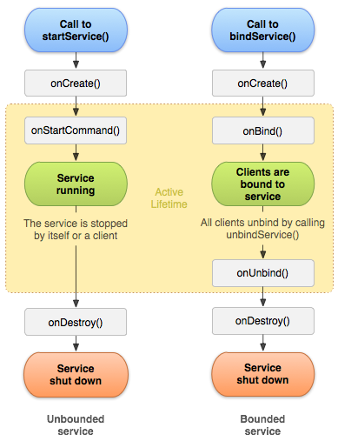
Service Life-Cycle
Started Service (Unbounded Service):
Initiated when an application component calls the startService() method.
Continues running in the background even if the component that started it is destroyed.
You can stop the service using either the stopService() method or the service itself can stop using stopSelf().
Bound Service:
Functions like a server in a client-server interface.
Components can send requests to the service and retrieve results.
A service becomes bound when an application component calls bindService().

Slide 41
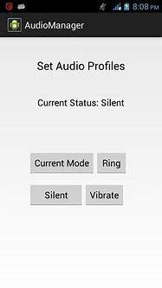
Working with AudioManager
AudioManager is a class provided by Android which can be used to control the ringer volume of your Android device. With the help of this Audio Manager class, you can easily control the ringer volume of your device.
Audio Manager Class can be used by calling the getSystemService() method in Android. When you create Audio Manager Class then you can use setRingerMode() method to change the ringer volume of your device.
The setRingerMode() method takes an integer parameter to set the ringer profile of your device.
There are three different integer parameters that need to be passed in setRingerMode() method are as follows:
RINGER_MODE_NORMAL
This mode will set your device mode to Normal/General mode.
RINGER_MODE_SILENT
This mode will set your device mode to Silent mode.
RINGER_MODE_VIBRATE
This mode will set your device mode to vibrate mode.

Slide 42
AudioManager audioManager = (AudioManager) getSystemService(Context.AUDIO_SERVICE);
// current mode will store current mode
// of ringer of users device..
currentmode = audioManager.getRingerMode();
switch (currentmode) {
case AudioManager.RINGER_MODE_NORMAL:
currentStateTV.setText("Ringer Mode");
break;
case AudioManager.RINGER_MODE_SILENT:
currentStateTV.setText("Silent Mode");
break;
case AudioManager.RINGER_MODE_VIBRATE:
currentStateTV.setText("Vibrate Mode");
default:
currentStateTV.setText("Fail to get mode");

